Slide 1
Macroplastics as a driver for (micro)plastic pollution
Practical and regulatory solutions
Laura Geßner | Circular Economy Expert | German Environmental Aid
2022-05-03 | Microplastics in Lakes – Impacts and Approaches to Solutions
Notes:
Presentation of the German Environmental Aid

Slide 2
Problem Outline
Notes:
Give you a quick agenda. First start with an outline of the problem and some numbers
So later on we can talk about practical and regulatory solutions

Slide 3
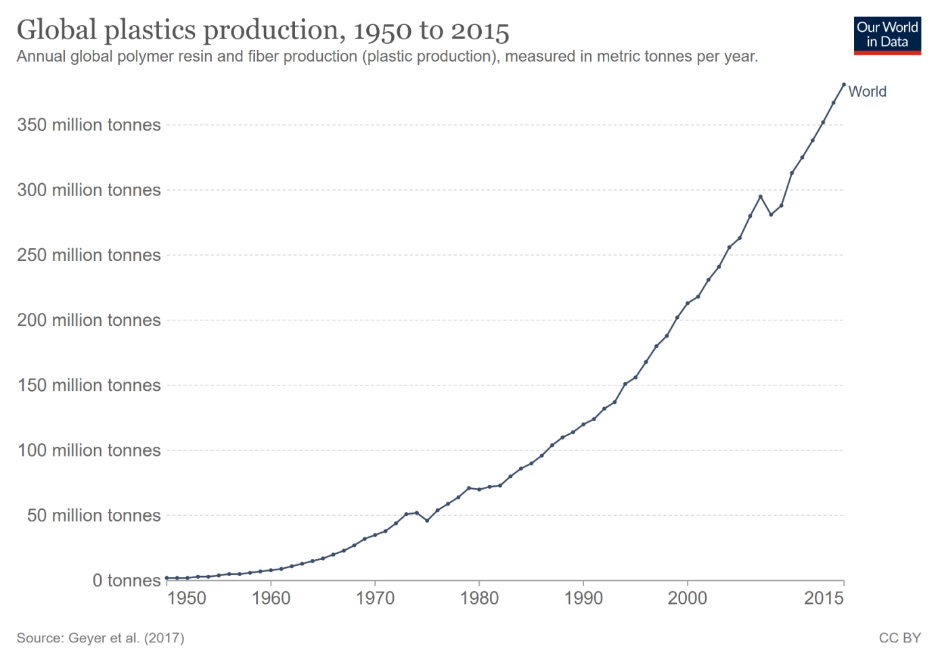
Some numbers on plastics
© CC BY Roland Geyer https://commons.wikimedia.org/wiki/File:Global-plastics-production.png
Global plastics production doubled from 2000 to 2019 to reach 460 million tonnes. Plastics account for 3.4% of global greenhouse gas emissions (OECD)
Notes:
- Probably you have seen
-since their invention, production of plastics has risen dramatically
- There is no end in sight

Slide 4
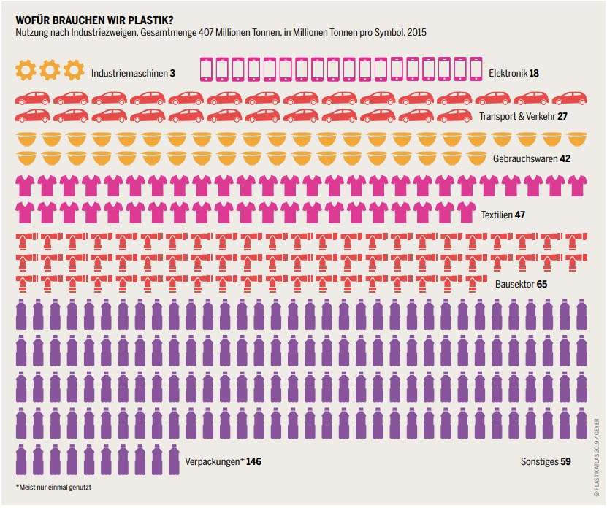
Packaging accounts for > 35% of plastic production
Heinrich Böll Stiftung, Plastik-Atlas
> packaging 90% single-use
Notes:
So what do we do with all this plastic?
First and foremost, we produce a lot of packaging, around 35 to even 40 % of the global plastic production goes into packaging
Construction, clothing and mobility are important as well
But packaging is by far the most important
And at least 90% comes form single-use packaging, so packaging that is bought, used once and then thrown away
→ Just keep these number in mind

Slide 5
Plastic emissions – macroplastics
116.000 tons macroplastics per year ( = 1,4 kg / capita) in Germany, according to the Fraunhofer Institute
Total plastic emissions are 449.500 tons with macroplastics making up 26%
According to the OECD, 22% percent of global plastic waste is mismanaged, going to uncontrolled dumpsites, burned in open pits or ending up in the environment, with e.g. 109 million tonnes having accumulated in rivers
Evidence indicates that freshwater environments act as both source of plastic pollution to the marine environment, as well as sink, potentially preventing a proportion from reaching the oceans
macroplastic
Quelle: Fraunhofer-UMSICHT, Juni 2018
UBA: Mikroplastik im Meer – wie viel? Woher?; Fraunhofer UMSICHT 2018; OECD : Plastic pollution is growing relentlessly as waste management and recycling fall short, says OECD
Notes:
Let‘s talk a bit about macroplastics and how they are polluting the environment
Estimates for Germany say, that about a quarter of plastic emissions comes from
Macroplastics
Numbers from the OECD about global plastic waste expect 22% to be mismanaged - uncontrolled dumpsites, burning in open pits or just ending up in the enviroment
109 million tons are expected to having accumulated in rivers
For freshwater environments , such as the lakes as today‘s topic, they are said to be a source for marine plastic pollution but also as a final sink for plastic waste

Slide 6
Macroplastics – aftermath of littering
Main source of macroplastics
Land-based sources of macroplastics account for the largest share in plastic pollution with littering being the most important
Littering – improper disposal of waste, either voluntary or unintentionally (blow-trash…)
The exact amount of litter that is released into the environment each year is difficult to determine. Estimations are around 1.3–3.5 kg per capita for Germany
Lechthaler ett.al : Way of Micoplastic through the Environment“; Fraunhofer UMSICHT;
Notes:
So where do these macroplastics come from?
Land-based
Probably not surprising:
Mainly: littering – so waste being dumped in an improper way
Riverbanks, roadsides, streets,…
Numbers for Germany – very different in different countries, depending on consumption patterns and waste management

Slide 7
Littering – packaging as the main culprit
Studies revealed that packaging items, such as bottles or food wrappers, make up half of the 10 most commonly found litter items in EU rivers;
In deep sea dives at depths > 6000 m, from all man-made items collected, 52% were macro-plastic and 92% of those single-use packaging
According to estimates, 3.4 – 5.7 million tons of secondary microplastic particles are generated annually by the fragmentation of plastic waste in Europe, with packaging making up 59 % of plastic waste
Wintton et. Al.: Macroplastic pollution in freshwater environments: Focusing public and policy action; Schwarz et.al.: „“Sources, transport, and accumulation of different types of plastic litter in aquatic environments: A review study, UBA 2015
Notes:
So what is being littered?
Again, not surprising,
Mainly packaging
For example… → This packaging is then degrading into microplastics, as Mr.Imhof explained

Slide 8
Littering – most common findings at EU beaches
Plastic bottles
Plastic bags
Single-use cutlery and stirrers
Cups and lids
Food containers
Crisp bags/sweet wrappers
Plastic straws
Cotton buds
Cigarette filters
Sanitary applications
Notes:
What types of packaging is being littered?

Slide 9
Interim conclusion
Macroplastics are an important driver of microplastic pollution
Most macroplastics stem from Littering
Packaging is the most frequently littered item, with certain items being especially problematic (bottles, bags, take-away containers)
How can the amount of littered packaging leading to microplastic pollution be reduced?

Slide 10
Practical Solutions

Slide 11
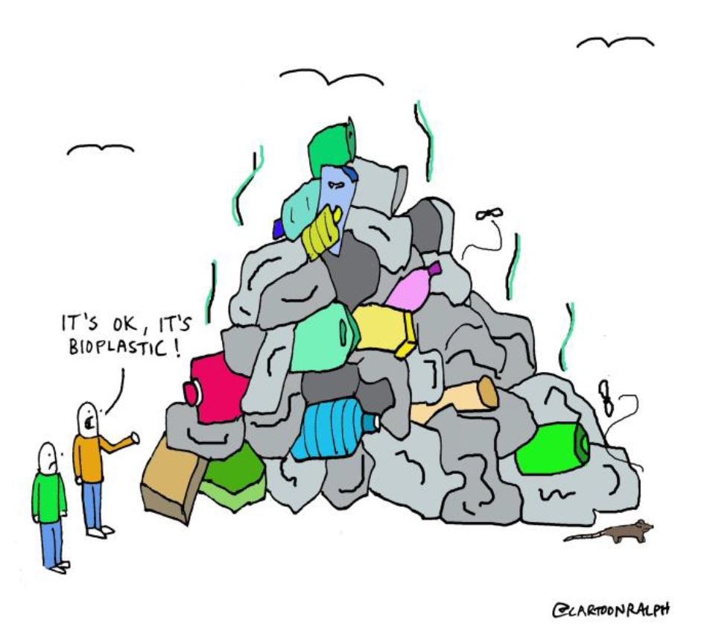
Bio plastics – the solution?
Competes with food production
Mostly non-recyclable
Pseudo-biodegradability
…
Bioplastics aren’t the solution
© DUH
Notes:
Touted as the solution by many in the industry
Idea is appealing – no longer need fossil fuels, just throw that into the bio-waste and it degrades
Well, from our experience that is not what happens
Typically, bioplastics are not more environmentally friendly compared to conventional plastics.
In nature, biodegradable plastics often do not degrade faster than conventional plastics and could even lead to more plastic littered.
EN 13432 and EN 17033 don’t guarantee full degradation in due time and could lead to non-degradable residues.
German composting plant operators tend to rate compostable plastics as contaminant, e.g. as it causes additional costs or does not degrade in time.

Slide 12
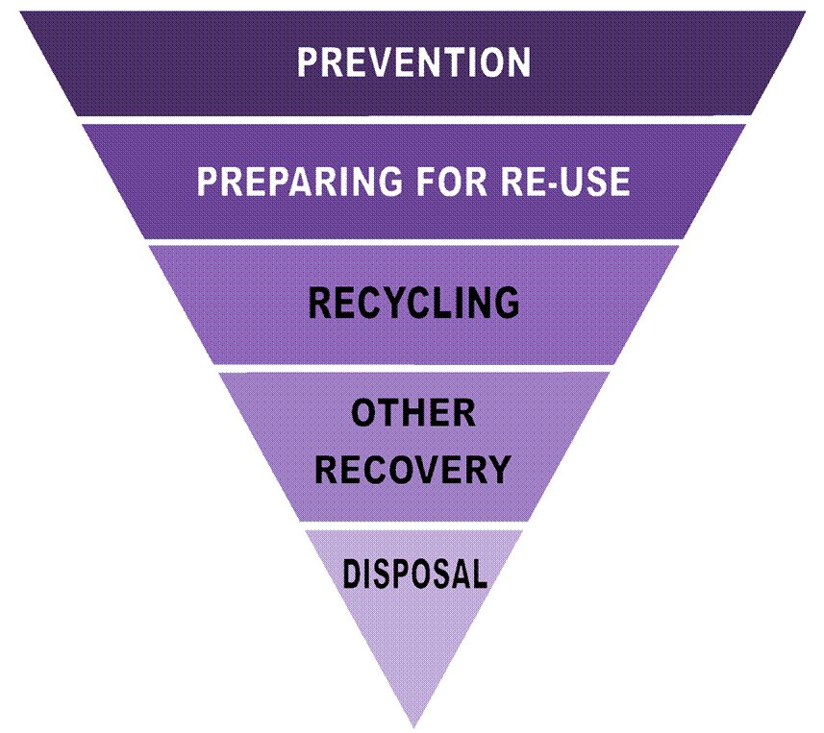
The solution: application of the waste hierarchy
Globally, only 9%, downcycling, …
Incineration (loss of resources,
Greenhouse gas emissions)
Landfilling (loss of resources,
methane emissions)
“Prevention and reuse offer the greatest potential for resource and climate protection." (Federal Environment Agency)
Notes:
Hierarchy at the heart of circular economy
Start at the bottom: with the non-solutions
Idea of waste prevention: we think, any and all packaging, that isn‘t neccessary, should be avoided
We need to tackle the problem at the source
Remember all that plastic being made into single-use packaging?
We need to reduce the amount of packaging produced an sold,
By not producing it and using reusable solutions wherever possible, to reduce plastic pollution from macroplastics
This also is important with regard to the resource and climate crisis

Slide 13
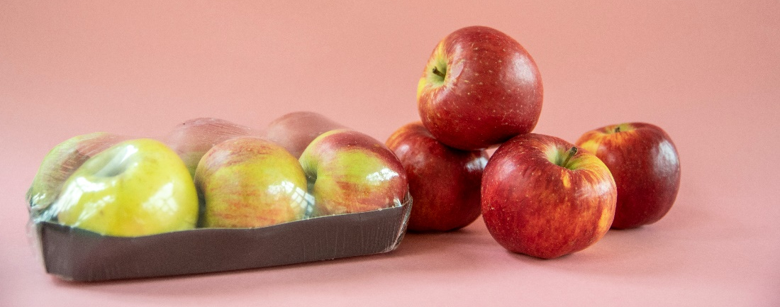
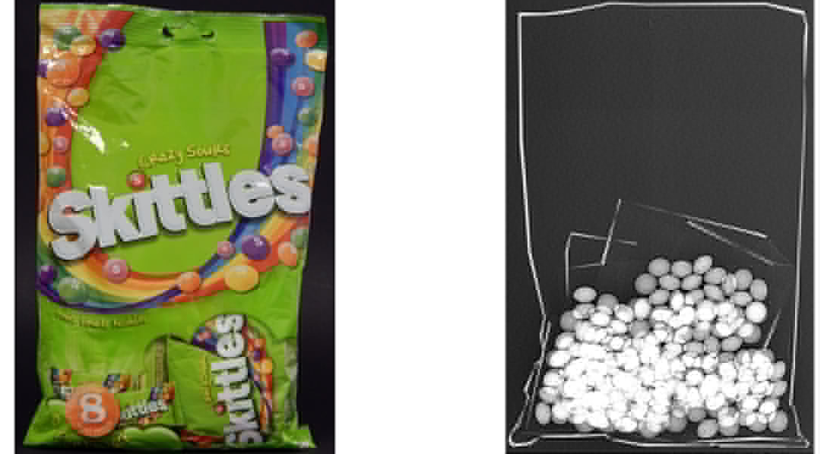
Prevention: remove or redesign unneccessary/oversized packaging
Notes:
How do we prevent packaging waste?
Do not use it, wherever unneccesary

Slide 14
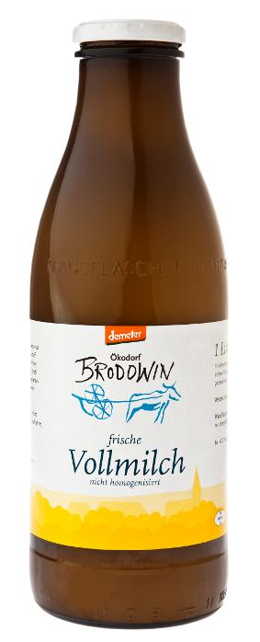
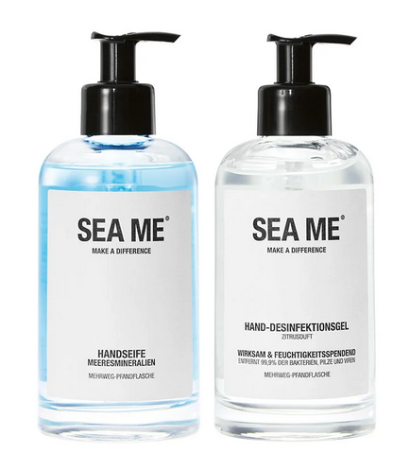
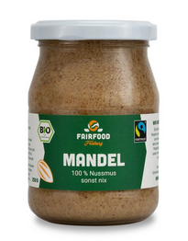
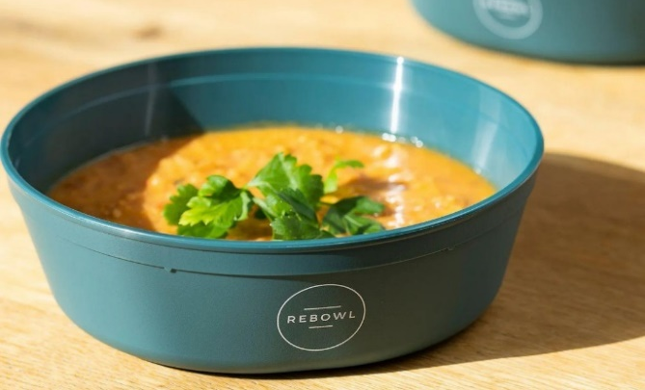
Reusable packaging: possible applications
© Finke DUH FAIRFOOD; Ökodorf Brodowin; Demeter; SEA ME; Recup, Vytal
Notes:
Wherever not using any packaging, we should us e reusable and refillable obne
Such as beverages – hard to sell without packaging
Germany, 40 % of beverages are sold in refillable bottles – we‘d like this to be even higher, and the standard everywhere
Also, for a lot of the other problematic types of packaging, such as take-away-packaging, there are successfull companies, that have reusable systems up and running
-> plastic in itself is not the problem
Also other products…

Slide 15
Regulatory Solutions
Notes:
But how do we make this a reality?
Well, we need to have coniditons, that do favour waste prevention and reusable solutions
Right now, the produce, use, waste systems do dominate
We need policy to counteract that

Slide 16
§
Recommended policies
Set waste reduction targets
Define reuse targets/quotas
Fiscal and other financial incentives
Better labeling and consumer information
Provisions for Green Public Procurement
→ UN Treaty on plastic pollution
EU Packaging and Packaging Waste Directive
National Packaging laws
Notes:
I‘ll gi into detail on the policy recommendations

Slide 17
Waste reduction targets & reuse targets
Waste reduction targets for packaging waste
Counteract ever-rising amounts of packaging waste
Measurability & Accountability
Reuse targets for different packaging types
Highlight this crucial step in the waste hierarchy
Improve conditions for higher market share, for established and new reuse systems
Notes:
target should lead to less (over)packaging material in general and more widespread reuse solutions
packaging waste should decrease by 25 percent by 2025 and 50 percent by 2030 relative to baseline value in every EU Member State

Slide 18
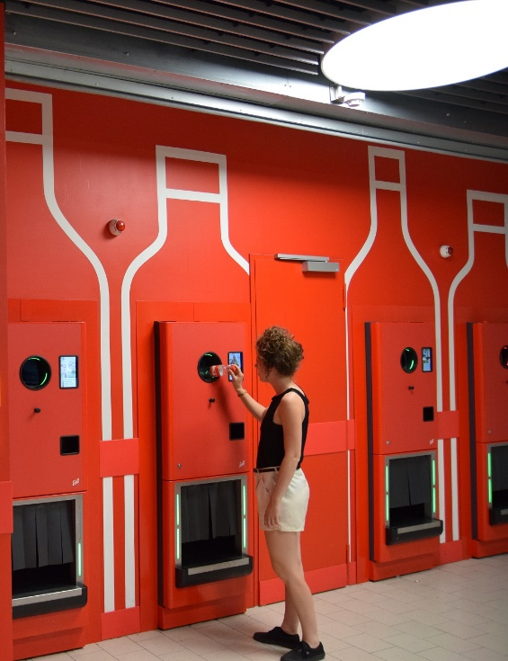
DRS and fiscal/ financial incentives
Introduction of wide-scale DRS on single-use beverage packaging (Deposit Return System)
stop leakage of beverage packaging into the environment (98% return rate in the German DRS)
best-possible collection & recycling
pave the way for a transition to refillables
Financial incentives
Taxes/fees that internalize external costs (Primary resource tax, EU plastic tax…)
Levies on single-use packaging (the Irish plastic bag levy reduced consumption by 90% in its first year)
Folien-Layout „Mit-Erklärung“

Slide 19
Better labeling and green public procurement
Clear labelling of ‚single-use‘ and ‚reuse‘
allows for consumers to choose more environmentally friendly
Lessens chances for Greenwashing
Green Public procurement
Reusable packaging should be mandatory for all public authorities, e.g. schools, universities, administration
Public bodies as role models
Improve market share (German public procurement: 500 billion annually)
Notes:
Cities have the option of stipulating a reuse requirement in their waste statutes for events on public land.
urch den Einsatz von wiederverwendbaren und bruchsicheren Produkten aus Kunststoff wird die ressourcen- und energieintensive Herstellung von insgesamt mehr als 280.000 Einwegartikeln verhindert.

Slide 20
Thank you very much for your attention.

Slide 21
© Heidi Scherm/DUH
Laura Geßner
Expert Circular Economy
Environmental Action Germany
Phone: +49 77 32 99 95 - 469
e-mail: gessner@duh.de

Slide 22
We fight for nature, the environment and consumers!

